Slide 1
Sub-brand to go here
Pro Global Science Association International symposium
Advancing the use of socio-economic research in policy-making across Europe
Dr Caroline Kenny

Slide 2
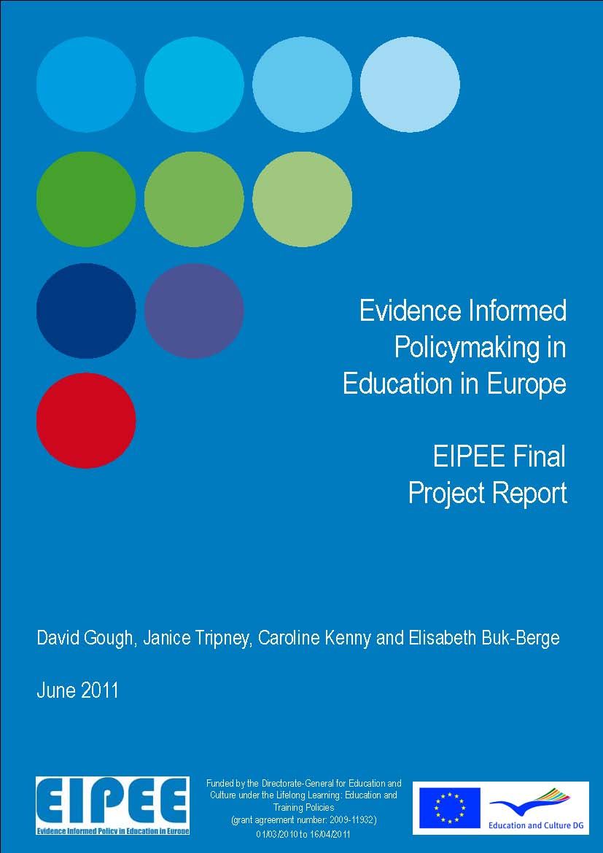
Notes:
My name is Caroline Kenny and I am here to talk to you about how the use of socio-economic research can be advanced by focusing on the needs of policy-makers.
My talk draws on research undertaken as part of a European Commission funded project titled ‘Evidence Informed Policy in Education in Europe’. This was a one-year project that ended in April 2011. The project aimed to identify:
The range of activities (both formal and informal) that are used across Europe for linking research and policymaking in education;
The scope and nature of studies that have examined the extent, process and/or efficacy of activities (both formal and informal) that are used across Europe to link research and policymaking in education.

Slide 3
Importance of evidence informed policy and practice
"Member States and the EU institutions need to use evidence-based policy and practice, including robust evaluation instruments, to identify which reforms and practices are the most effective, and to implement them most successfully. Education and training have a critical impact on economic and social outcomes. Ineffective, misdirected or wasteful education policies incur substantial financial and human costs.”
European Commission (2007) 'Towards more knowledge-based policy and practice in education and training' SEC (2007)1098
Notes:
Increasing the use of evidence in education policy is an explicit objective of many national and international policy-making organisations including the European Commission and the Organisation for Economic Co-Operation and Development. It is also a growing concern for researchers as a consequence of the decision by many funders and commissioners to require verification of research impact as a condition of funding.

Slide 4
Is research important for decision-making?
Yes but…
Notes:
So what is evidence informed policy? Well, it has been defined as an approach which “helps people make well informed decisions about policies, programmes and projects by putting the best available evidence at the heart of policy development and implementation” (Davies 1999a).
It can be contrasted to opinion-based policy, which relies heavily on either the selective use of evidence or, on the untested views of individuals or groups that may be based on ideology, prejudices or speculation.
In this presentation I am using a very broad understanding of research that refers to all types of research, whether qualitative or quantitative, primary research or synthesised, whether this synthesis is empirical or more conceptual.
When most people think about evidence informed policy they think about a mechanical process where research informs policy directly but we know that this is not the case. Research is just one of many factors that affect policymaking and things like political priorities, the availability of resources and other contextual factors are also important and have to be considered.

Slide 5
Types of research use
Direct versus indirect use
  Where decision-making is based directly on research or, it affects understanding indirectly and maybe unintentionally.
Conscious versus unconscious use
  Decision-makers are to different degrees aware that they are using research.
Types of research use
Inform versus support decisions
  Where research is used to persuade or support existing thinking.
Timing
  Where research is used immediately or in the future.
Notes:
Similarly, we also know that research can be used in many different ways.
Although most people think about the direct or instrumental use of research by decision-makers this is actually the least common type of research use. More common, but harder to identify, is the unconscious or indirect use where research influences the beliefs or attitudes of decision-makers. This is often referred to as the enlightenment approach to research use.
Also important is the extent that research informs decisions or is used strategically to support decisions already made and, timing is a crucial factor because often it can take years for ideas from research to become prevalent within decision-making. This depends on the decision-making context at the time, the views and ideologies of those involved, the different actors, traditions etc.

Slide 6
Research evidence production-to-use system
MEDIATION
System level
STAKEHOLDER ENGAGEMENT
EVIDENCE PRODUCTION
EVIDENCE
USE
RESEARCH ON EVIDENCE PRODUCTION AND USE
Notes:
What do we mean by evidence informed policy and practice?
Here is a diagram of a very simple model to understand the evidence-to-use process. This model situates evidence and its use within a broader system that takes into account those individuals and organisations who mediate between the two (what is variously referred to in the literature as ‘knowledge brokerage’, ‘mobilisation’ and ‘exchange’). This involves making connections between producers of research evidence and its users with the overt purpose of bringing them together and facilitating greater interaction (see (Canadian Health Services Research Foundation)).
It also acknowledges the role of other stakeholders in this process and the wider system in which interactions between all of these actors take place. There is a high level of interactivity between individuals, organisations and time within this system and the system itself is dynamic, interdependent and adaptive (Stewart and Oliver 2012: 234).
This understanding of the evidence-to-use process also highlights the importance of studies on this process, what is referred to as ‘research on evidence production and use’. Through such research, we can gain knowledge and understanding about the different components involved in the evidence-to-use process and the interactions between them. This can contribute to a firm evidence base in which to inform future knowledge brokerage (see Gough et al 2011: 57).
In describing the different strategies that can be used to encourage evidence use within decision-making, there is an implicit distinction between those approaches focused on the production side and those addressed towards users.
‘Push’ strategies are those focusing on producing, communicating or disseminating research evidence out to potential users and include activities such as publishing newsletters or producing research summaries or policy briefs.
‘Pull’ strategies focus on encouraging demand for the uptake of research evidence by addressing the needs of potential users and on the organisational and political contexts that shape their use of evidence. These strategies could include activities such as training policy-makers or practitioners in how to find, use or understand research evidence or the use of experts in decision-making.

Slide 7
Focus of activities within the research evidence production-to-use system
Notes:
Overall, the EIPEE project found 269 examples of activities linking research with policy-making across Europe.
Of this, we found 52 activities that were predominantly concerned with the use of evidence in policy-making.
This equates to around 1/5 (19%) of the total (269) activities identified that linked research evidence with policy.
Contrasts with 67% (181) activities predominantly concerned with the production and/or communication of research evidence.

Slide 8
Classifying research-to-policy activities by type
Advisory (for example experts)
Capacity building (for example training)
Information services (for example databases)
Interpersonal networks and events (for example seminars)
Research outputs (for example reports)
Research and analysis (for example Ministries’ internal analytical departments)
Staffing arrangements (for example secondments)
Strategy, investment and development (for example funding)
Notes:
We classified the 269 activities into 27 different types, which we then grouped into eight overarching categories.
These eight categories are shown here.
Advisory
Advisory/monitoring groups/committees
Experts
External consultancy
Capacity building
Training
Information services
Bibliographic databases/libraries
Other web-based information services
Interpersonal networks and events
Informal relationships
Meetings (incl. seminars/conferences)
Networks
Research outputs
Analytical reports
Newsletters
Specialist journals
Summary reports of research/policy briefs
Research and analysis
Staffing arrangements
Strategy, investment and development

Slide 9
Types of activity used to assist policy-makers
Notes:
The biggest proportion of activities focused on the context of evidence use were those concerned with capacity building, which constituted nearly a third of all activities in this area. This was followed by activities focused towards the staffing arrangements of users (such as those concerned with job roles) at 21%.
Advisory: Within the overarching category of ‘Advisory’, the survey identified activities including ministries’ use of experts (particularly those from academic backgrounds). The use of experts was identified both at an individual level (where individual ‘experts’ were brought in by ministries to advise them on research) and at a more collective level where panels of experts and other advisory type bodies were created in response to requests from policymakers. Such activities incorporate the use of official bodies such as Commissions of Inquiry or Select Committees that use research to investigate and scrutinise specific issues.
Research and analysis: The types of ‘research and analysis’ activities that were found within the context of research use included research centres offering capacity building training for decision-makers; and ministries with internal analytical departments that actively sought and/or analysed/interpreted research evidence in order to inform decision-making. Also identified were think tanks that typically focused on the development of practical policy-making solutions based on sound evidence, thus blurring the boundaries with policy-making.
Interpersonal networks and events: Within the category of ‘interpersonal networks and events’, the survey found the following examples. First, networks that organised workshops and other training events (including bespoke training). Second, breakfast meetings held by a group within a national parliament to bring together politicians and experts from academia and elsewhere to discuss particular issues. Third, informal relationships between decision-makers and academics; and fourth, meetings organised by ministries to which key academics were invited.
Capacity building: Activities under this category comprised workshops, courses and other training events including professional development activities. The latter emphasised the importance of ‘learning’ in enabling evidence informed decision-making. Identified activities also comprised a ministry that set up a specific competency framework (and accompanying training module in evidence informed policy-making) which all staff was required to complete to build internal capacity and ensure that all staff had the necessary skills to find, use and interpret relevant research evidence.
Staffing arrangements: Within this category, examples of secondments were found in which researchers and/or policymakers were transferred from their regular organisation for temporary assignment elsewhere (i.e., researchers to government organisations and decision-makers to academic units). These were used principally to facilitate the development of skills and knowledge exchange. Also identified here were the recruitment of staff with experience (past or present) of academia and/or research into ministries; and the active support of ministry staff in acquiring research skills.

Slide 10
Type of actor setting up and managing activities
National governments/government-related organisations
Academic organisations
International governments/government-related organisations
Research organisations not based in universities or governments
Mixed
Notes:
Five different types of actors were responsible for setting up and ultimately controlling the continuance of these activities.
This included:
national governments or government-related organisations;
academic organisations/universities;
international government/government-related organisations;
research organisations that were neither university- or government-based;
Combination of these actors
Overall, we found that national governments were responsible for setting up and ultimately controlling activities assisting policy-makers’ use of evidence, comprising nearly 70% of the total.
International governments or government-related organisations were responsible for setting up 12% of activities, while academic organisations or universities set up 10%.
A further 10% were set up by a combination of actors while research organisations that were neither university- or government-based set up 6%.

Slide 11






Mechanisms to support research use
Interaction/ Collaboration
Incentives/
Reinforcement
Accessibility
Facilitation
System focus
Education
Relevance
Social
influence
Seek and/or interpret
Notes:
We found nine mechanisms that were being used to enable research evidence informed policymaking.
These were:
Accessibility
Making research outputs accessible/available (i.e., more "readily found"). This mechanism emphasises the importance of ensuring/increasing policymakers’ access to research.
Relevance
Ensuring a relevant research base through the production of relevant research and/or by enabling relevant research to be produced. This mechanism emphasises the importance of ensuring that there is an existing relevant evidence base from which policymakers can draw (whether or not it is made available).
Education
Developing/increasing knowledge, understanding/awareness and/or skills in relation to four areas: producing relevant research, finding relevant research, analysing relevant research and using relevant research. The underlying mechanism here is learning.
Incentives/reinforcements
Motivating individuals/organisations to change behaviour through incentives or any other reinforcements. This mechanism assumes that behaviour can be influenced by controlling external stimuli.
Social influence/persuasion
Relying on influential others (influential due to social/professional standing/status) to provide information about research and to persuade them of its value. This mechanism emphasises the importance of the attitudes and behaviour of ‘significant others’ in prompting change.
Facilitation
Giving practical assistance to individuals/organisations through technical, financial, organisational and emotional support. This mechanism emphasises the importance of providing the means to take action and removing barriers to that action.
Seek and/or interpret
This mechanism is characterised by a focus on the importance of seeking out and/or analysing/interpreting research evidence in order to inform decision-making.
Interaction/collaboration
Developing stronger links and collaborations between the research and policy communities (individuals and/or groups). This mechanism emphasises the importance of a two-way flow/production of information/knowledge.
System focus
Making changes to the functioning/coherence of the relationships between the contexts of research production, mediation and decision-making. This mechanism emphasises the (strategic) importance of focusing on the evidence-to-policy system as a whole. It is a multi-faceted category that at any time can encompass one or more of the prior listed 7 mechanisms. However, it also encapsulates the principle of ‘the sum is greater than the parts’.

Slide 12
Mechanisms used to assist policy-makers
Notes:
In terms of the particular means that these activities sought to achieve evidence informed policy and practice, the survey identified five mechanisms within the context of evidence use. These are the mechanisms of education, facilitation, interaction/collaboration, seek and /or interpret and social influence (see Figure 5). Education is the most common mechanism used for both activities set up and ultimately controlled and those run or managed on a daily basis. This is followed by the mechanism of seek and/or interpret. In contrast, the mechanisms of interaction/collaboration and social influence are the least common mechanism employed, constituting only 12% of all user-focussed activities. Facilitation is the second least mechanism with 17% use however; this is nearly half the amount of the next most common mechanism: seek and/or interpret.
The identification of linking activities using the mechanism of interaction/collaboration may be somewhat surprising given that this mechanism focuses on achieving a two-way flow of information between researchers and users and may therefore be expected within the context of mediation. It features here because although activities were identified that focused on bringing decision-makers into contact with researchers, these activities did not have the explicit purpose mediation or brokerage.

Slide 13
Implications
Raise awareness across all countries in Europe.
International collaboration.
European collaboration.
Greater role for other actors to set up or manage activities, or for actors to collaborate on this.
Scope for different types of activity and mechanisms to assist policy-makers use of research.
Notes:
There are many implications/lessons we can draw from the findings presented in the previous section. These are organised into four categories: country, actor, activity and mechanism.
4.1: Implications from countries
The EIPEE survey did not identify linking activities specifically focused on the needs and contexts of users in eight eligible European countries. Furthermore, only 14% of activities had ongoing active work with international partners or were formally focused internationally and only 6% of activities had partners or were formally focused exclusively within Europe. While we need to be careful in interpreting these results due to limitations of data collection methods (see section two), these findings suggest that more effort could be made to raise awareness of the importance of user-focussed interventions as a means to achieving evidence informed policy and/or building capacity to enable actors to implement and manage such interventions in the eight countries where no such activities were identified. Furthermore, more attention could be given to cross-country collaboration and learning in the establishment and operation of such activities, particularly within Europe where there is little active collaborative work.
4.2 Implications from actors
EIPEE findings on the types of actors that were responsible for setting up and managing these activities on a day-to-day basis reveal the dominance of national government/government-related organisations. This is a positive sign that suggests that European governments are taking calls for evidence informed policy and practice seriously. However, it may also put such efforts at risk given the uncertainty and instability of many national economies and the retraction of many national governments from the provision of much of public policy and civil society. This may lead to a reduction in the number of linking activities national governments/government-related organisations themselves are able to set up and/or manage on a day-to-day basis and may also impact upon the abilities of other types of organisations (including academic/universities and those based outside of the university and government sectors), that are recipients of national government funding. This suggests that other types of actors such as international governments/government-related organisations, commercial organisations and those funded by other sources (such as not-for-profits, other non-governmental organisations and charities funded outside of the state sector could assume more of a role. Equally, there is much scope for collaboration across these different types of actors in the provision of user-focussed activities. The input of these actors need not necessitate both the setting up and management of these activities because this can vary between different actors as the findings show (see Figures 6 and 7). Thus, while one actor may take responsibility for setting up an activity, responsibility can be devolved to another actor for its running and management.
There may also be a role for actors to become more involved in different types of activities. While the survey indicates that national governments/government-related organisations and academic/universities are involved in the running or management of all five overarching types of user-focussed activities (even when not necessarily responsible for setting them up), some actors focus on specific types of activities and do not employ a diverse portfolio of activities for this purpose. It is unclear whether this is because of resource limitations, weaknesses in capacity or unwillingness and thus action could be taken in all of these areas.
4.3 Implications from activities
The EIPEE survey found five of a possible eight overarching types of activity. Some of this is to be expected as certain overarching categories of activity pertain specifically to particular areas of the evidence-to-use process. For example, we would not expect much representation of research outputs category to be found in those activities focussed on assisting policy-makers as these are addressed more to the production, presentation and dissemination of research evidence. Equally, the activities within the overarching category of strategy, investment and development pertain more to the evidence production and systems level then they do to the context of evidence use. Nevertheless, we may have expected some activities to feature here. For example, the survey did not find any examples of external consultancy (overarching category: advisory), government-related public bodies or professional organisations (overarching category: research and analysis) that assisted policy-makers in using evidence. This combined with the finding that nearly a third of user-focussed approaches comprised capacity building activities, suggests a lack of awareness about the range of activities that can be used to assist policy-makers in using evidence or, a lack of knowledge and/or skills in how to set up and run such activities. If this is the case then there is clearly a role for the greater dissemination of the knowledge provided through the EIPEE project and the funding of further activities (both research and capacity building) in this area. However, it may also be a consequence of a lack of participation from certain types of actors in undertaking such activities. In which case, more effort could be targeted to raising levels of interest, willingness and capability of these actors in engaging in such activities.
4.4 Implications from mechanisms
Five mechanisms to achieve evidence informed policy and practice were identified within the context of evidence use. These are the mechanisms of education, facilitation, interaction/collaboration, seek and /or interpret and social influence. Notable by its absence is the mechanism of incentives/reinforcement. The use of this mechanism evidence to assist practitioners in using evidence has been widely documented within the health care field (see Grimshaw et al 2001; Thomson O’Brien et al 2000; Oxman et al 1995; for arguments for the use of incentives in encouraging greater use of evidence by policy-makers see (Hanney, Gonzalez-Block, Buxton, & Kogan, 2002)). The EIPEE findings show a reliance of the mechanism of education in achieving more evidence use within policy-making. Given the widely documented need for capacity development within policy-making this is both unsurprising and welcome ((Green & Bennett, 2007; Nuyens, 2007)). Although caution should be given to application of the results from other sectors to education, we should also consider the evidence available from both education and other sectors that shows that increasing the interaction and collaboration between researchers and users is extremely effective in increasing the likelihood that evidence is used (Cordingley, Baumfield, Butterworth, McNamara, & Elkins, 2002; Cousins & Simon, 1996; Huberman, 1990, 1993; Lavis et al., 2005; Nutley et al., 2009; Walter et al., 2003b; Walter, Nutley, & Davies, 2005). Moreover, it may be also worth considering evidence that shows the effectiveness of employing more than one mechanism to increase the use policy-makers use of evidence, what is referred to in the literature as multi-faceted (or multi-component) interventions (Bero et al., 1998b; Boaz, Baeza, & Fraser, 2011; Grimshaw et al., 2001; Nutley, Percy-Smith, & Solesbury, 2003; Nutley et al., 2009; Walter et al., 2003b, 2005).

Slide 14
What is the EIPPEE project doing to help?
Building an international network.
Free training course places .
Improving access to research through a new portal
Free consultancy service to help policy-makers and practitioners to use evidence.
Increasing mediation of evidence to encourage new activities linking it with policy and practice
Support to develop methodologically rigorous research;
Exploring the use of social media to enhance communication and facilitate collaboration.
Exploring the possibility of developing a set of indicators that can be used to self-assess work and develop good practice.

Slide 15


Thank you
EIPPEE website: http://www.eippee.eu
c.kenny@ioe.ac.uk
EPPI-Centre
Social Science Research Unit
Institute of Education
University of London
18 Woburn Square
London WC1H 0NR
Tel +44 (0)20 7612 6397
Fax +44 (0)20 7612 6400
Email eppi@ioe.ac.uk
Web eppi.ioe.ac.uk/
The EIPPEE project is led by a central team at the EPPI-Centre, which is part of the Social Science Research Unit at the Institute of Education, University of London

